Slide 1
Tablet Computers in the Classroom: A Kindergarten Teacher’s Study
Lydia S. Smith
EDUC 6304
Fall 2012

Slide 2
Strategy
New digital tools are changing the way children look at the world around them
Targeted use of the iPad can enhance traditional teaching methods
Possible PTA purchase of iPads for the Kindergarten students at our school
THESIS:
The use of the iPad will show an increased engagement of kindergarten students which in turn will lead them to be able to recall specific sight words more successfully

Slide 3
Resources/Literature Used
Jukes, I., McCain, T., Crockett, L., & Prensky, M. (2010). Understanding the digital generation: Teaching and learning in the new digital landscape. Corwin press.
Ortega, C., & Ortega, R. (1995, February). Integrated elementary technology education. The Technology Teacher.
Reid, D. & Ostashewski, N. (2011). iPads in the Classroom – New Technologies, Old Issues: Are they worth the effort?. In T. Bastiaens & M. Ebner (Eds.), Proceedings of World Conference on Educational Multimedia, Hypermedia and Telecommunications 2011 (pp. 1689-1694). Chesapeake, VA: AACE. Retrieved from http://www.editlib.org/p/38089.
VanSlyke, T. (2003, May/June). Digital Natives, Digital Immigrants: Some Thoughts from the Generation Gap. The Technology Source. Retrieved November 19, 2012, from http://ts.mivu.org/default.asp?show=article&id=1011

Slide 4
Literature Review
The iPad allows for easy multidimensional interactions with one connected device
The iPad allows users to move from application to application with ease
For younger students, this makes it easier to access rich content and resources

Slide 5
Literature Review
Very little actual research exists specifically on the iPad and the elementary classroom (Reid, Ostashewski, 2001)
The limited research available shows that student behavior changes with more open access to information (Reid, Ostashewski, 2001)
Students are able to search for more information in less restrictive environments (Reid, Ostashewski, 2001)
Students rely less on the teachers and more on their ability to explore, process and synthesize the information (Reid, Ostashewski, 2001)

Slide 6
Participants
Kindergarten classroom at Pecan Grove Elementary
Pecan Grove Elementary is part of the 4th largest school district in the state of Texas
The campus services 700 students from PreK through 5th grade.
Class room gender breakdown is 13 girls 7 boys. My test group was 6 girls 2 boys

Slide 7
Setting
Study was conducted in the Kindergarten classroom
Teacher is relatively proficient in integrating technology into various content areas and the classroom is well equipped with technology hardware.
The study was carried out during small group rotations

Slide 8
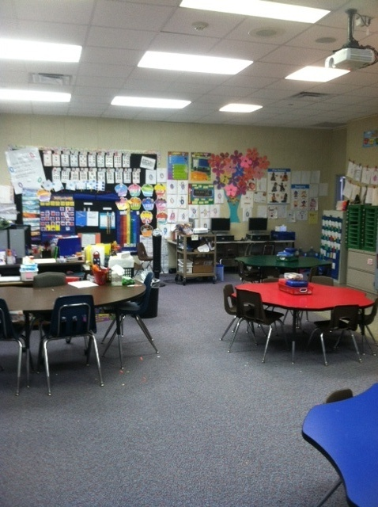
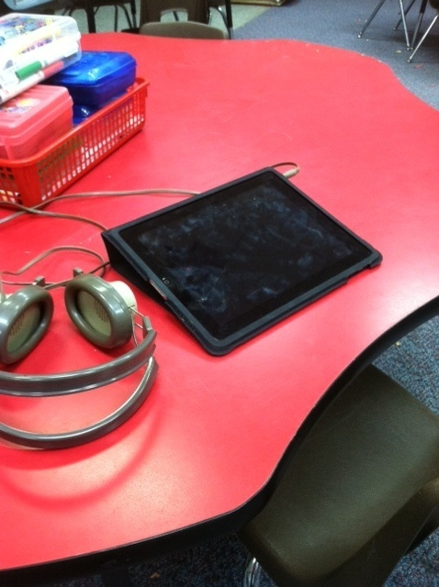
Setting

Slide 9
Procedures
Each student were shown a series 20 flashcards
Words missed were recorded
Students were reduced to a group of eight that knew 13 or less sight words
Sub categories were set up so that each group of four had a student who knew 0-5, 6-11 or 11-13. They were randomly chosen and placed into either the iPad Group or the Teacher Group

Slide 10
Procedures – iPad Group
Teacher modeled how to access and use the sight word apps that were pre-loaded onto the iPads
The apps were tailored to practice the 20 words being tested during the study
Students used the iPad for 10 minutes a day over a 5 day period
Once their 10 minute work time started, the students were at a table by themselves choosing which apps to play and for how long
Anecdotal notes were taken on relative levels of engagement and enthusiasm

Slide 11
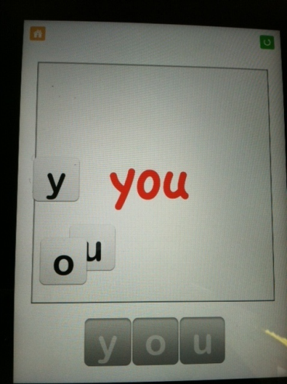
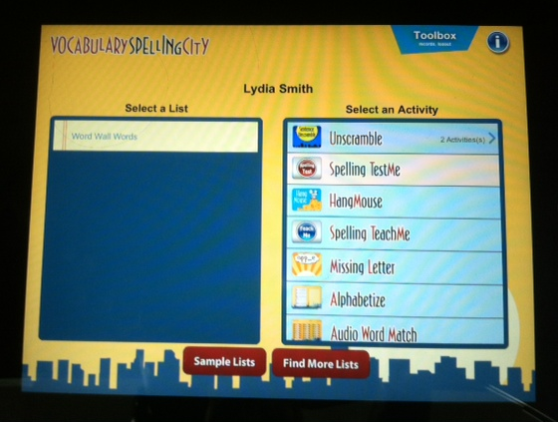
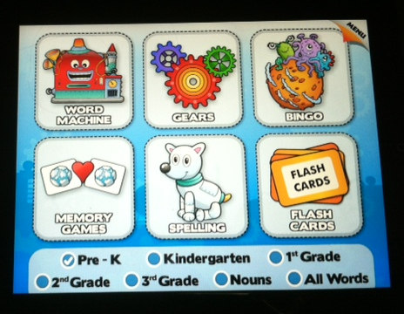
Procedures – iPad Group

Slide 12
Procedures – Teacher Group
Students met with the teacher for 10 minutes over a five day period
The teacher decided which game the group would play; the game practiced only the 20 words that were being tested in the study
All four students were playing the game simultaneously
Anecdotal notes were taken on relative levels of engagement and enthusiasm

Slide 13
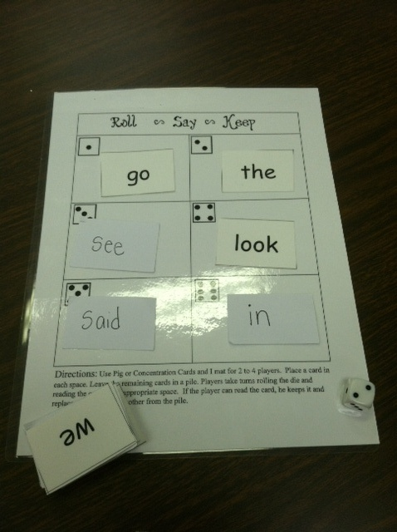
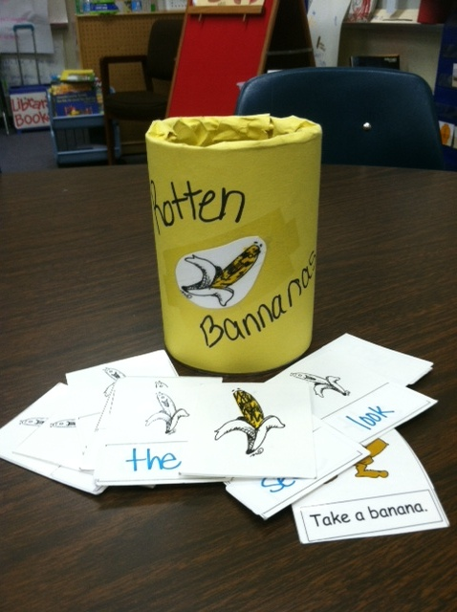
Procedures – Teacher Group

Slide 14
Procedures
At the end of the study all students were then re-tested on the 20 sight words and the number of words missed was recorded

Slide 15
Results
 |  | Site Words Correct |  | % Change
 |  | Prior to Study | After Study
 | iPad Group | 7 | 9.3 | 24%
 | Teacher Group | 8.3 | 15 | 82%

Slide 16
Anecdotal Notes
High level of enthusiasm showed by iPad group versus the teacher group
iPad users often “talked” to the iPad
Some iPad users struggled with the headphones and were off task building avatars
Teacher group more reserved; enthusiastic commentary typically showed only when the winner was announced

Slide 17
What would I change?
Increase in duration
Increase size of test group
Measure change in sight word recognition in “third” group of students
Measure the results of the iPad compared to student performance in a sight word center (independent practice during morning rotations)
Measure whether increased sight word recognition using an iPad leads to higher reading levels, better fluency and overall comprehension

Slide 18
What would I keep the same?
Sight word apps that practice specific words
Continue to use the iPad during small group rotations
Assign a small groups to use the iPads/play teacher made sight word games

Slide 19
Do my results agree with research?
The iPad gave students a sense of independence and choice
Students had to synthesize what was being asked on their own terms and answer accordingly
The iPad did provided value to their learning when thinking about the overall level of enthusiasm showed by the students – “buy in”
Kindergarteners maybe not be capable of using open access to technology to facilitate independent learning due to age/developmental issues

