Slide 1
How to tell a POWERFUL Story
Digital storytelling
Lydia s Smith
Lydia.smith@fortbend.k12.tx.us

Slide 2
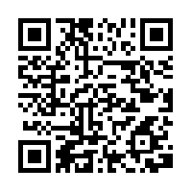
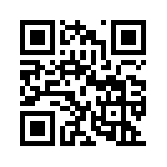
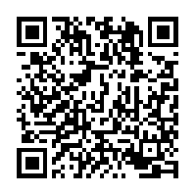
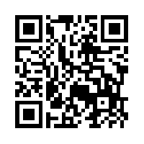
How to tell a POWERFUL Story
Presentation
LBT Website
“How To” Handout
Feedback!

Slide 3
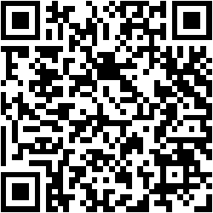
How to follow along………
OR go to:
http://goo.gl/HcbckM

Slide 4
All about Texas: A Kindergartener’s Perspective
http://goo.gl/cH703L

Slide 5
What is digital storytelling?
2-10 minute stories
Personal narrative to historical recreations (and almost anything in between!)
Traditional story telling - incorporating multimedia
Multimedia can include:
Graphics
Audio
Video
Web publishing

Slide 6
The Convergence of DS in Education
Student
Engagement
Project – Based
Learning
Technology
Integration
Reflection for Deep Learning
DIGITAL STORYTELLING

Slide 7
Why do it?
Students
Teachers
Increased motivation
Synthesize content
Improve communication skills
Easily present ideas to a larger audience
Easily share work with others
Fosters collaboration
Allows teachers to address various learning styles
Generate interest
Keep student attention
Address various learning styles
Enhance lessons or units
Make abstract content more understandable

Slide 8
Little Bird Tales
www.littlebirdtales.com

Slide 9
Student Login Cards

Slide 10
What Can I do with It?
Students
Teachers
Reports
Journals
Science experiments
History
Collaborative learning
Independent practice
Storybooks
Teaching aides
Interactive lessons
Formative assessments
Summative assessments
Home/school connections

Slide 11
4 Major Steps
Pre-Production
Production
Post Production
Distribution

Slide 12
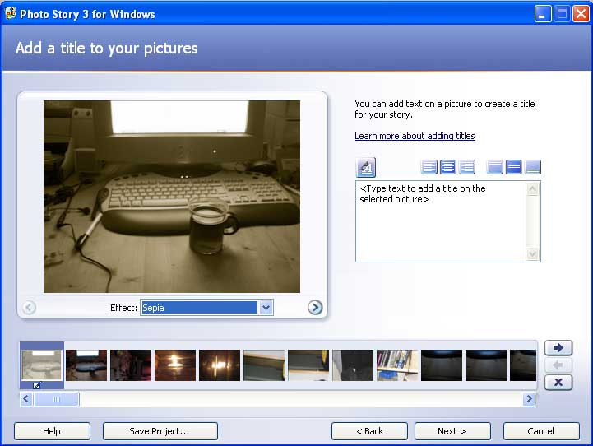
Other Digital Storytelling Ideas and Tools
Photostory 3 – free download for Windows

Slide 13
Other Digital Storytelling Ideas and Tools
ComicLife
http://blog.comiclife.com

Slide 14
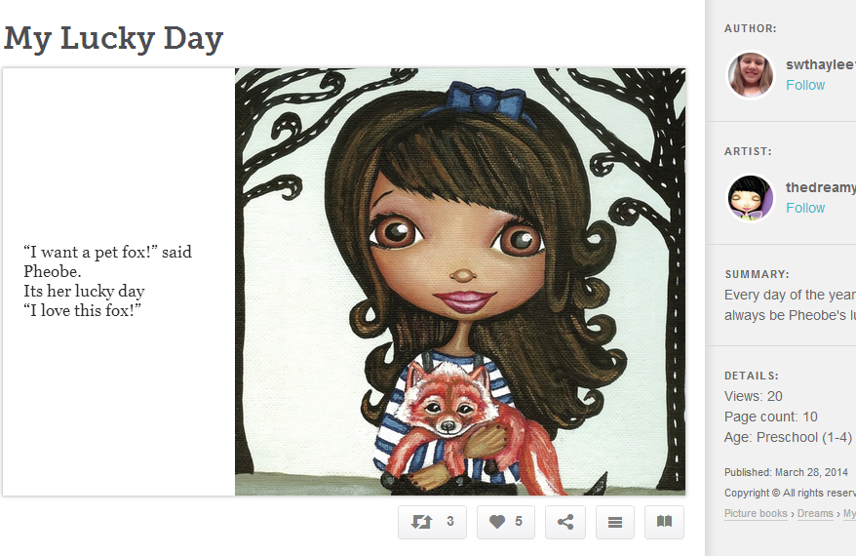
Other Digital Storytelling Ideas and Tools
StoryBird (free)
www.storybird.com

Slide 15
Other Digital Storytelling Ideas and Tools
Discovery Education – Discovery boards (fee based, but GREAT resource)
www.unitedstreaming.com

Slide 16
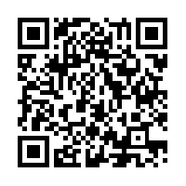
Other Digital Storytelling Ideas and Tools
Claymation with PowerPoint
http://goo.gl/k4w800
Notes:
Online poster creation platform

Slide 17
Did I convince you to use Digital Storytelling in your classroom?
http://goo.gl/qsJSXp

